Slide 1
VIGA
Vision-as-Inverse-Graphics Agent
Iterative Generate / Render / Verify Loop using VLMs + Blender
Project Summary | January - February 2026
Author: Yuna

Slide 2
Overall Pipeline Flow
Architecture Hierarchy
Iterative Pipeline
VIGA (top level)
Complete video-to-3D pipeline
Dual-agent: Generator + Verifier
SAM3D (core module)
Image + Mask -> 3D GLB mesh
Uses TRELLIS architecture
TRELLIS (Microsoft engine)
Sparse structure sampling
Dual decoder (GS + Mesh)
1. Input
2. SAM3D Init
3. Generator
Target image / video + text description
Segment objects + 3D reconstruct GLBs
Write Blender Python Import GLBs, compose scene
4. Blender
5. Verifier
6. Iterate
Execute script Render frames/animation
VLM evaluates render vs target image
Feedback loop until Verifier approves

Slide 3
Environment Setup
Windows 11 (Primary)
Linux / WSL2 (Tested)
OS: Windows 11 Home 10.0.26200
GPU: NVIDIA RTX 5080 16GB VRAM
CPU: AMD Ryzen 9 9900X
RAM: 32GB DDR5-6000
Conda Env: agent (Python 3.10)
- openai 2.6.1 (GPT-5 API)
- pillow 12.0 (image processing)
- numpy 2.2.6
- python-pptx 1.0.2
- mcp 1.20.0 (tool servers)
Conda Env: sam (Python 3.10)
- torch 2.10.0+cu128 (CUDA 12.8)
- torchvision 0.25.0+cu128
- segment-anything 1.0 (Meta SAM)
- opencv-python 4.13.0
Blender: 4.5 (EEVEE / Cycles GPU)
WSL2 Ubuntu (tested for SAM3D)
- CUDA passthrough from host GPU
- Higher VRAM efficiency vs Windows
- ~30% faster SAM3D inference
Key Issues Found on Windows:
- Path resolution: Blender CWD != script CWD
Fix: .resolve() all Path objects
- Pipe deadlock: use temp files
instead of capture_output=True
- Encoding: always utf-8
(Windows defaults to cp1252)
- Spaces in paths: quote subprocess args
VLM Model: GPT-5 (OpenAI API)
- Generator: writes Blender Python
- Verifier: evaluates renders vs target

Slide 4
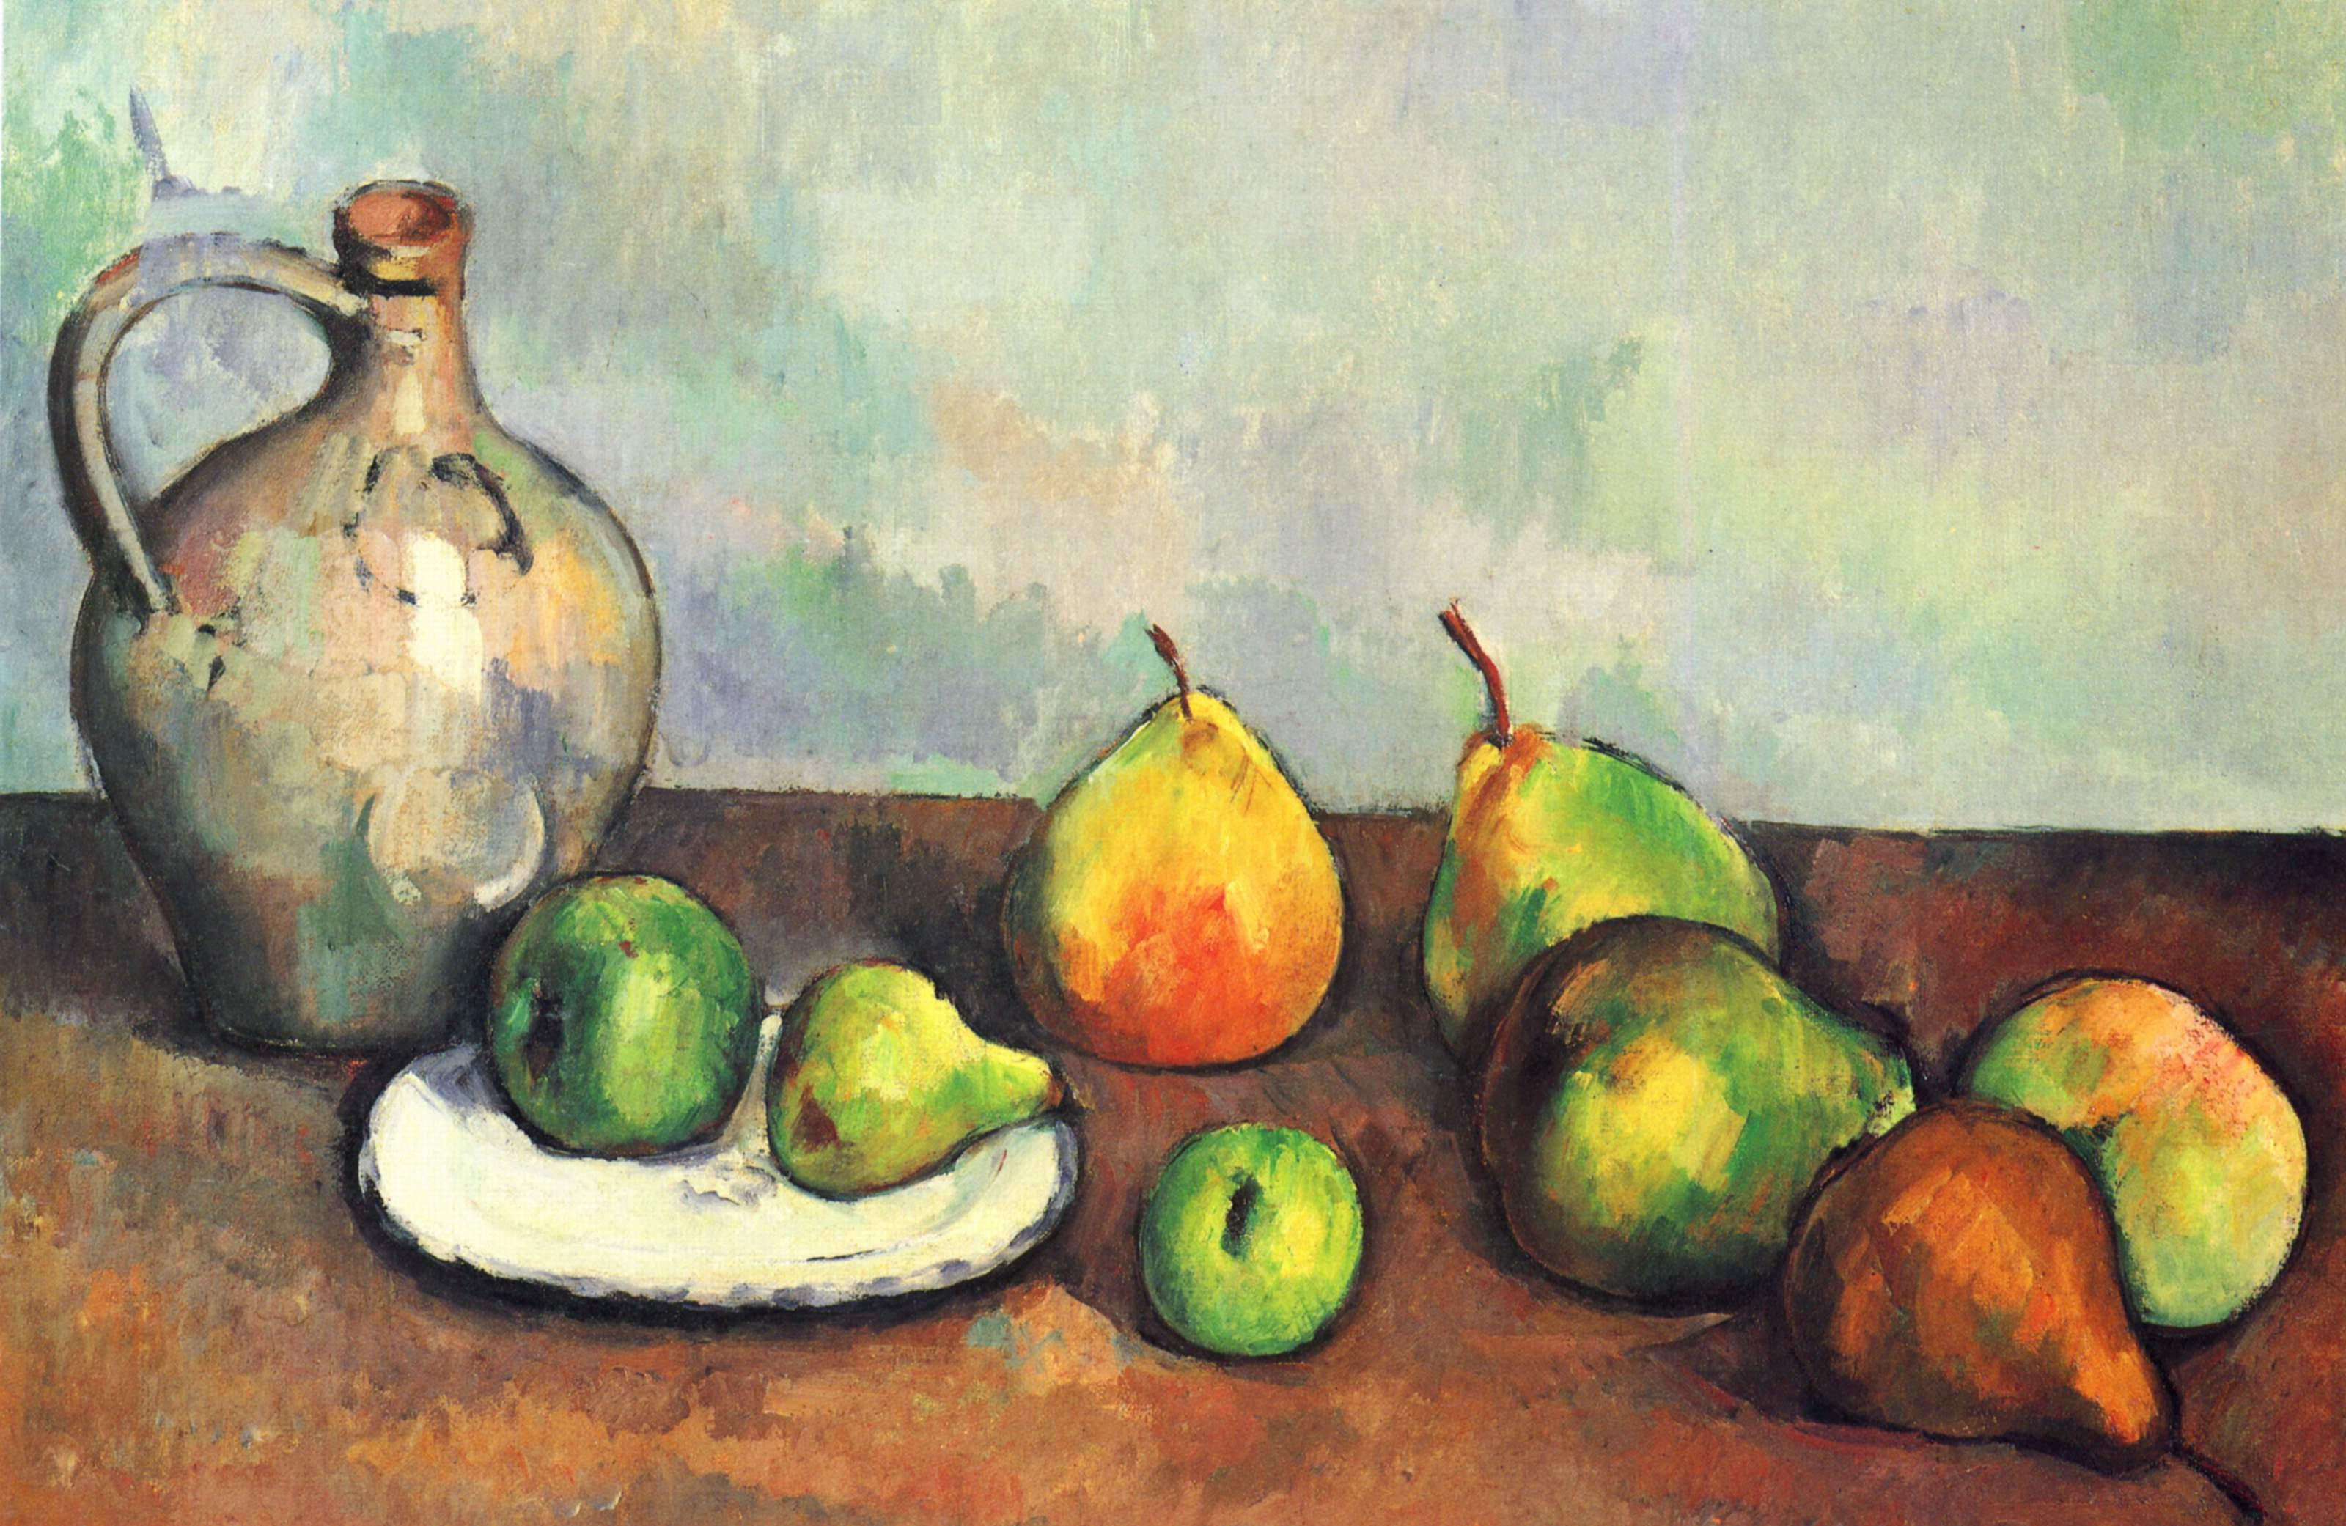
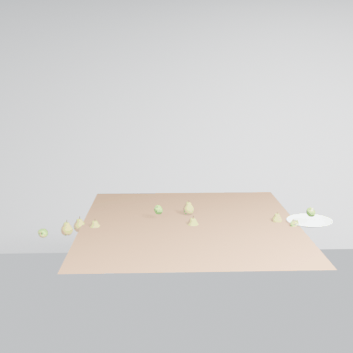
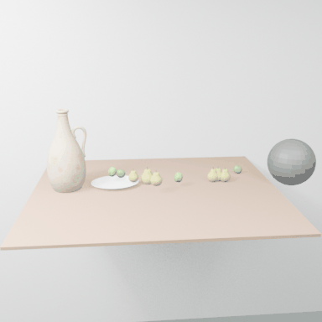
2026-02-11
Dynamic Scene: Artist Run 2 (SAM3D Injection Fixed)
SAM3D injection bug fixed. Pre-computed GLBs + pose transforms loaded via --sam3d-results flag. Generator kept 5/8 SAM3D objects (fruits), replaced jug/plate/pear with Meshy cache hits. 50% faster than Run 1 (99 min vs 203 min). 21 rounds with animation keyframes.

Slide 5
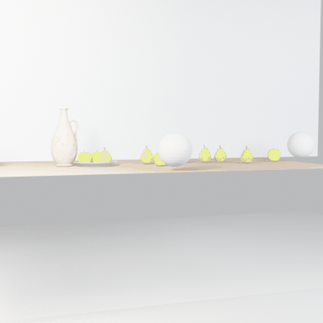
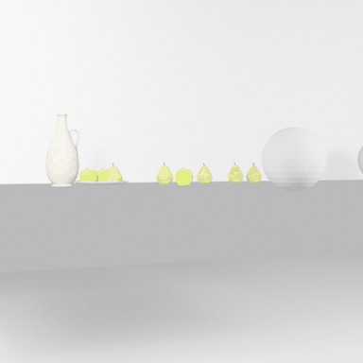
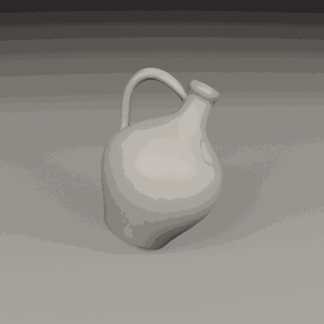
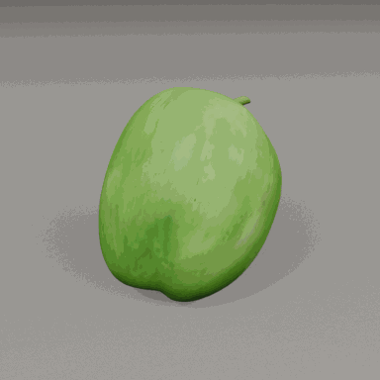
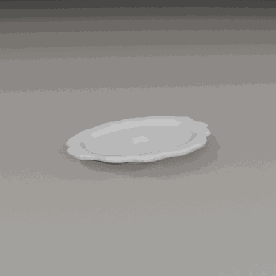
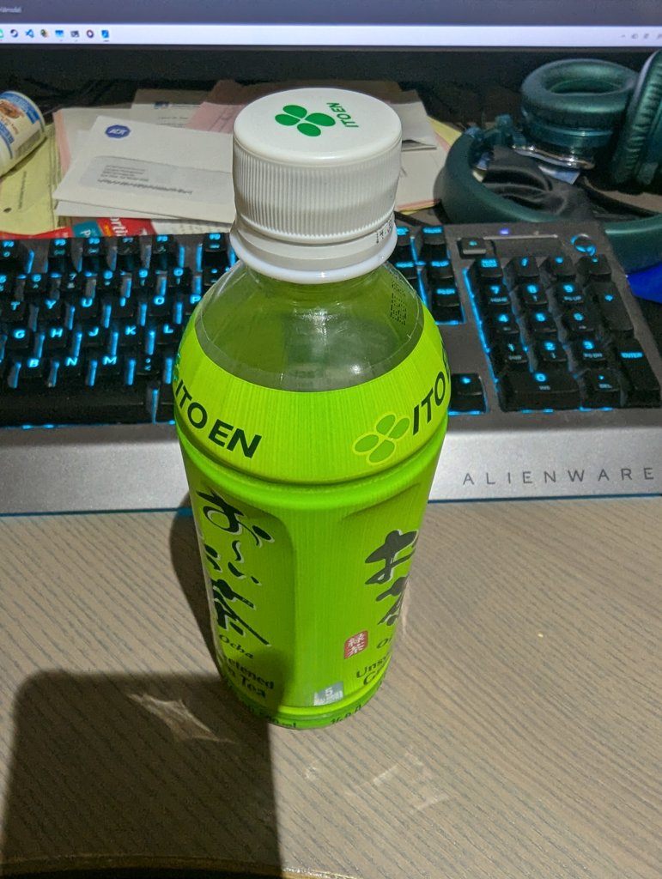

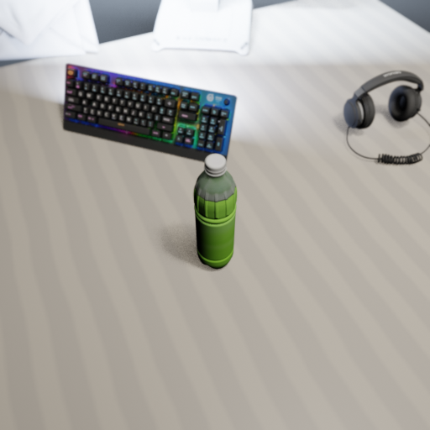
2026-02-10
Dynamic Scene: Artist Run 1 (SAM3D + Meshy)
First full SAM3D-initialized dynamic scene run. SAM3D reconstructed 8 objects with pose data. Discovered SAM3D injection bug: tool_client.py returns unwrapped dict but generator checked wrong key. Objects fell back to Meshy/procedural. 18 rounds, 203 minutes.
SAM3D 3D Reconstructions (8 Objects)
SAM3D reconstructed 8 objects from the Cezanne still life painting: ceramic jug, green apples, pears, orange pears, and plate with fruits. Each object includes pose data (translation, rotation, scale).
SAM3D + Meshy Combined Pipeline Design
Designed a combined pipeline: SAM3D initializes scene from target image, then Meshy replaces poor-quality reconstructions. Best of both worlds — SAM3D for layout + high-fidelity objects, Meshy for objects SAM3D reconstructs poorly.
SAM3D + Meshy Run 1 (Static Scene)
First combined SAM3D+Meshy static scene run. SAM3D auto-reconstructed objects, Generator evaluated quality and replaced poor ones via Meshy. 17 rounds producing increasingly refined green tea desk scene.

Slide 6
2026-02-10 (cont.)

Slide 7
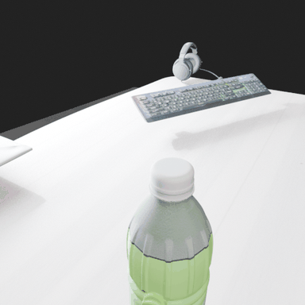
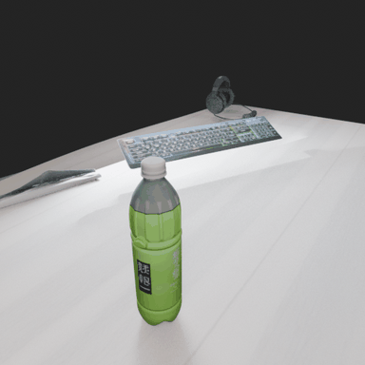
2026-02-09
Static Scene: Green Tea Run 10 & 11
Continued static scene refinement. Run 11 achieved 19 rounds with improved asset placement. Rotation GIFs showed progressive improvement in scene composition and lighting.

Slide 8
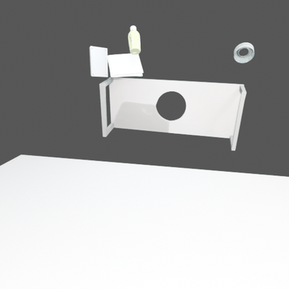

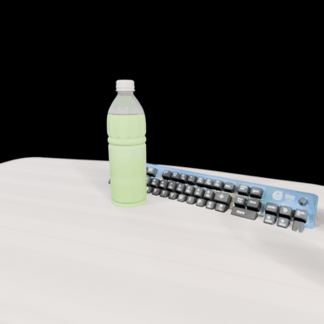
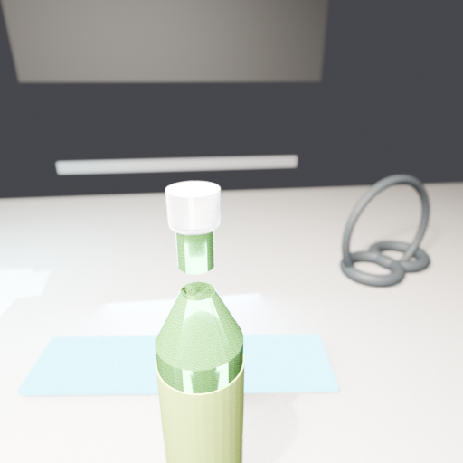
2026-02-08
Static Scene: Green Tea Runs 5, 7, 8, 9
Multiple static scene iterations. Run 5 first achieved successful GLB asset imports with absolute paths. Key fix: MeshyAPI path resolution to absolute paths with forward slashes. Two-phase prompt: asset acquisition (5 rounds) then scene composition.
Static Scene: Green Tea Asset Run
Asset acquisition run for the green tea desk scene. Generator attempted GLB imports but relative paths failed in Blender. Eventually fell back to procedural geometry. Led to the absolute path fix in meshy_api.py.

Slide 9
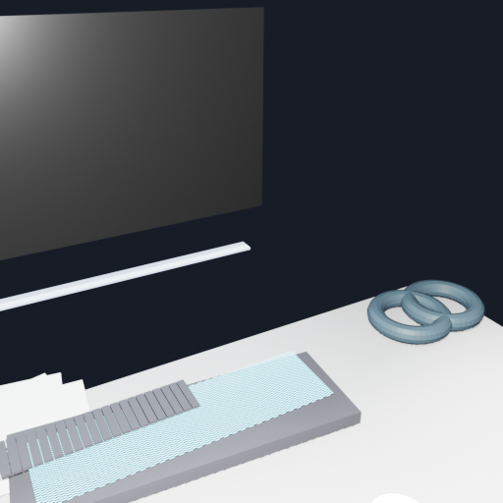
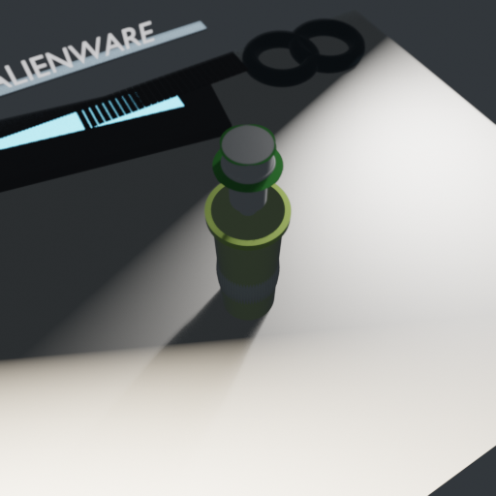
2026-02-07
Static Scene: Green Tea First Results
First full static scene run recreating a green tea desk setup. 58 rounds (longest run). Identified that Meshy local fuzzy matching works without API key. Discovered path resolution issues with Blender's working directory.

Slide 10
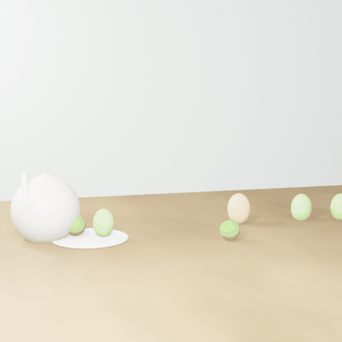
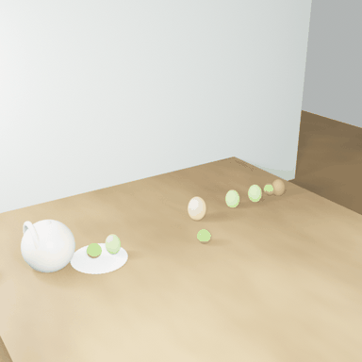
2026-02-06
Dynamic Scene: Artist Baseline
Baseline dynamic scene test with GPT-5. Reconstructed Cezanne still life as animated 3D scene. 12 rounds producing procedural scene with animation keyframes. No SAM3D or Meshy — pure VLM-generated Blender Python.
Windows Compatibility Fixes
Documented all Windows-specific issues encountered: Blender path resolution, subprocess pipe deadlocks, cp1252 encoding errors, and spaces in paths. Applied fixes to exec.py, investigator_core.py, generator.py, verifier.py, common.py.

Slide 11
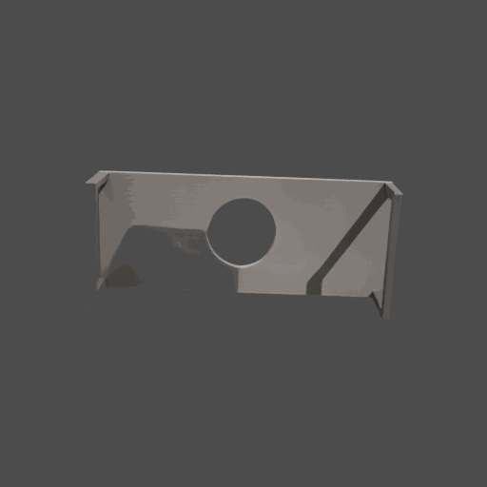
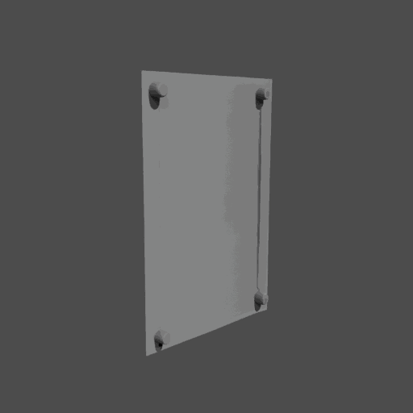
2026-02-05
SAM3D Pipeline Complete
End-to-end SAM + SAM3D pipeline completed. 100% success rate (5/5 objects) on green tea scene. Full workflow: SAM segmentation -> mask extraction -> SAM3D 3D reconstruction -> GLB export. ~2 hours processing on RTX 5080.

Slide 12
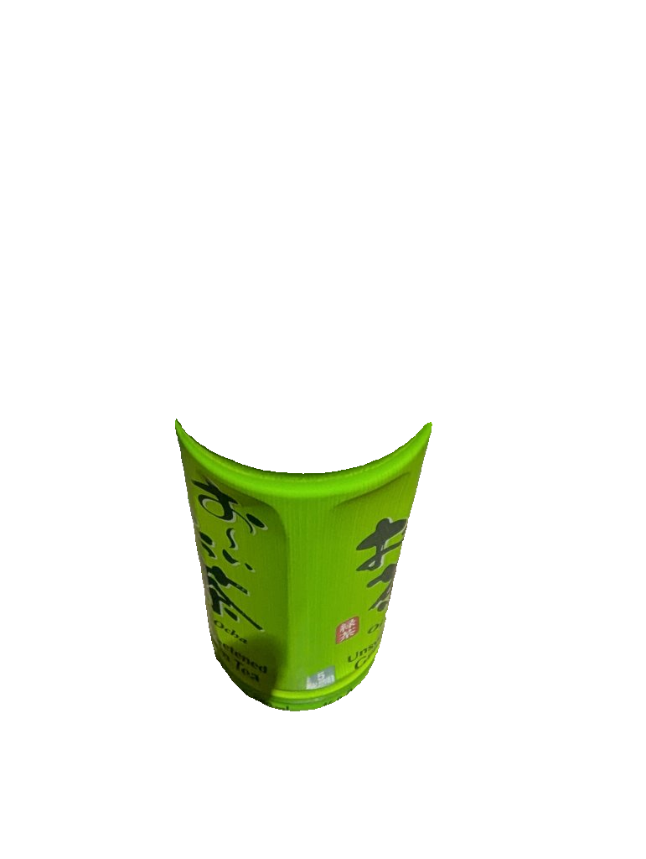
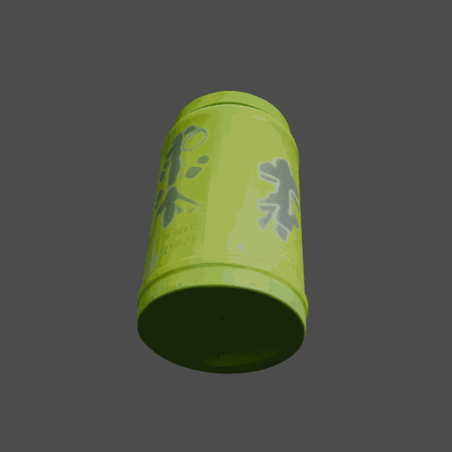
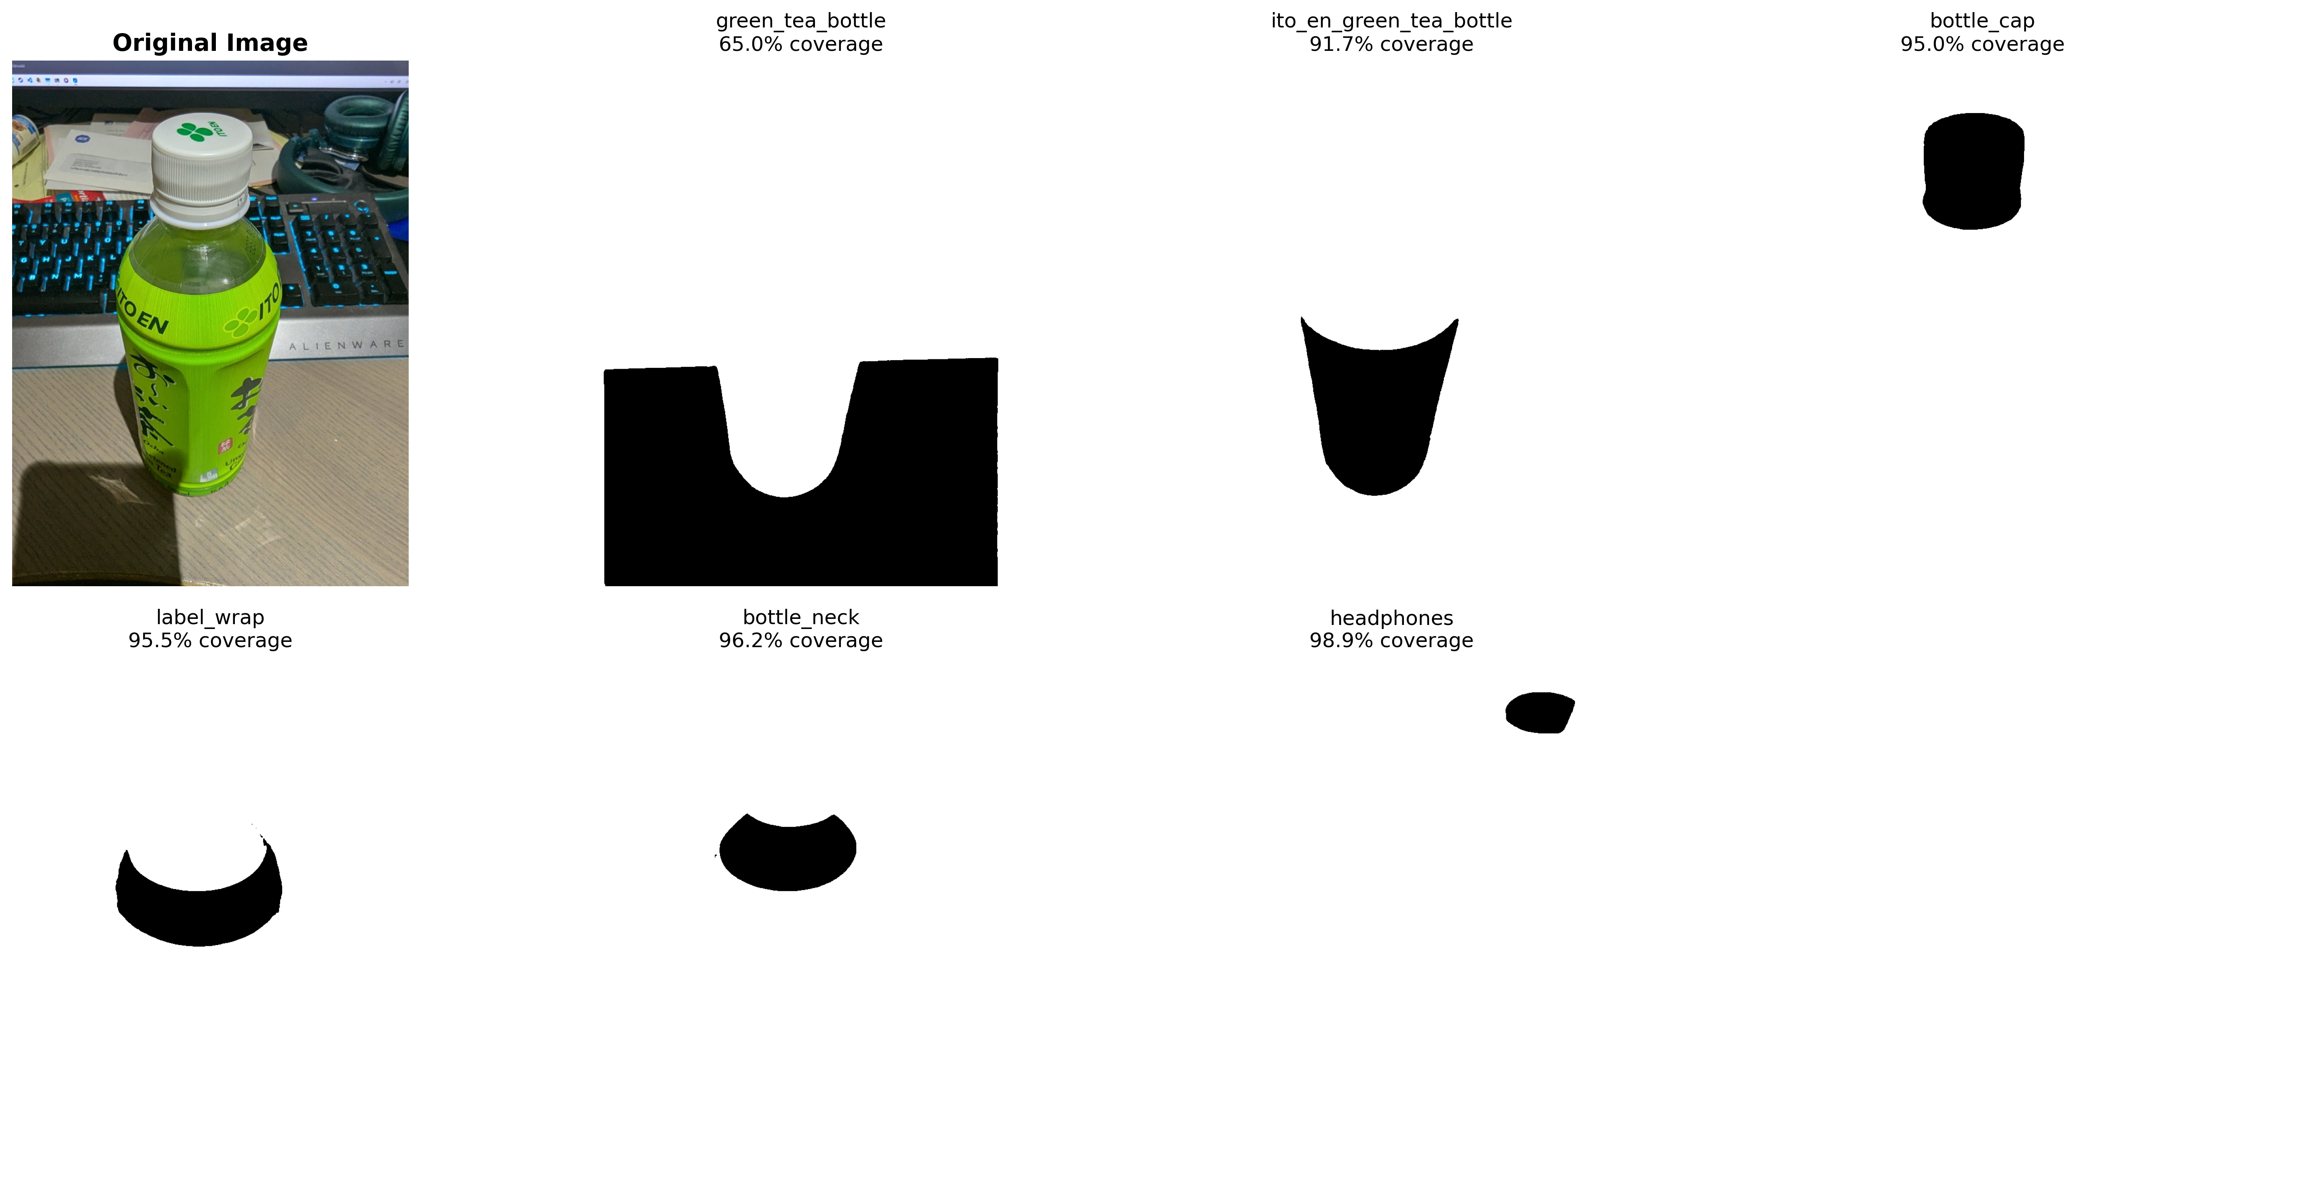
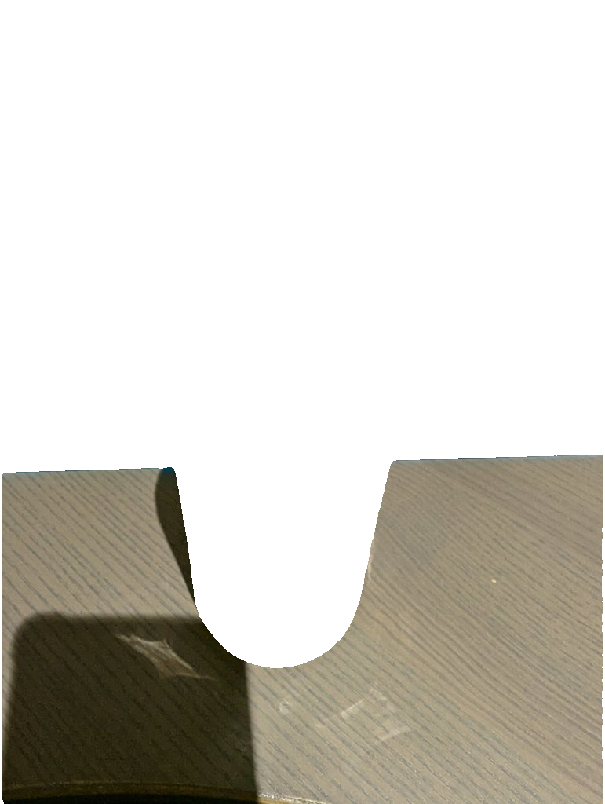
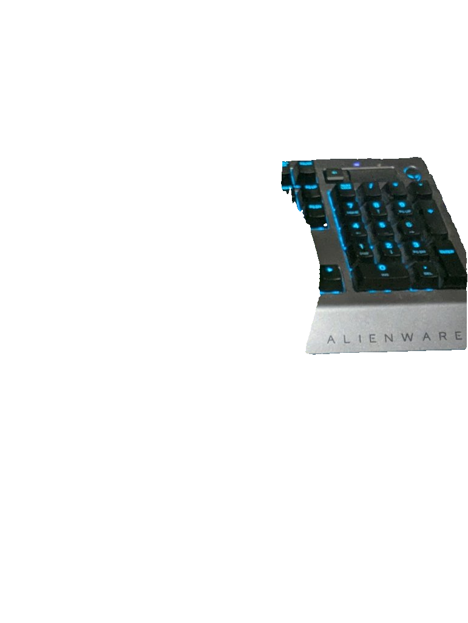

2026-02-04
SAM3D Optimization & All-Masks Approach
Tested SAM3D with all SAM-generated masks. Analyzed VRAM optimization and inference parameters. Compared mask quality and 3D reconstruction fidelity across different segmentation strategies.
SAM Segmentation Results
SAM (Segment Anything Model) segmentation analysis on the green tea desk scene. Successfully segmented 5 objects: green tea bottle, ito en bottle, keyboard, headphones, envelope.

Slide 13
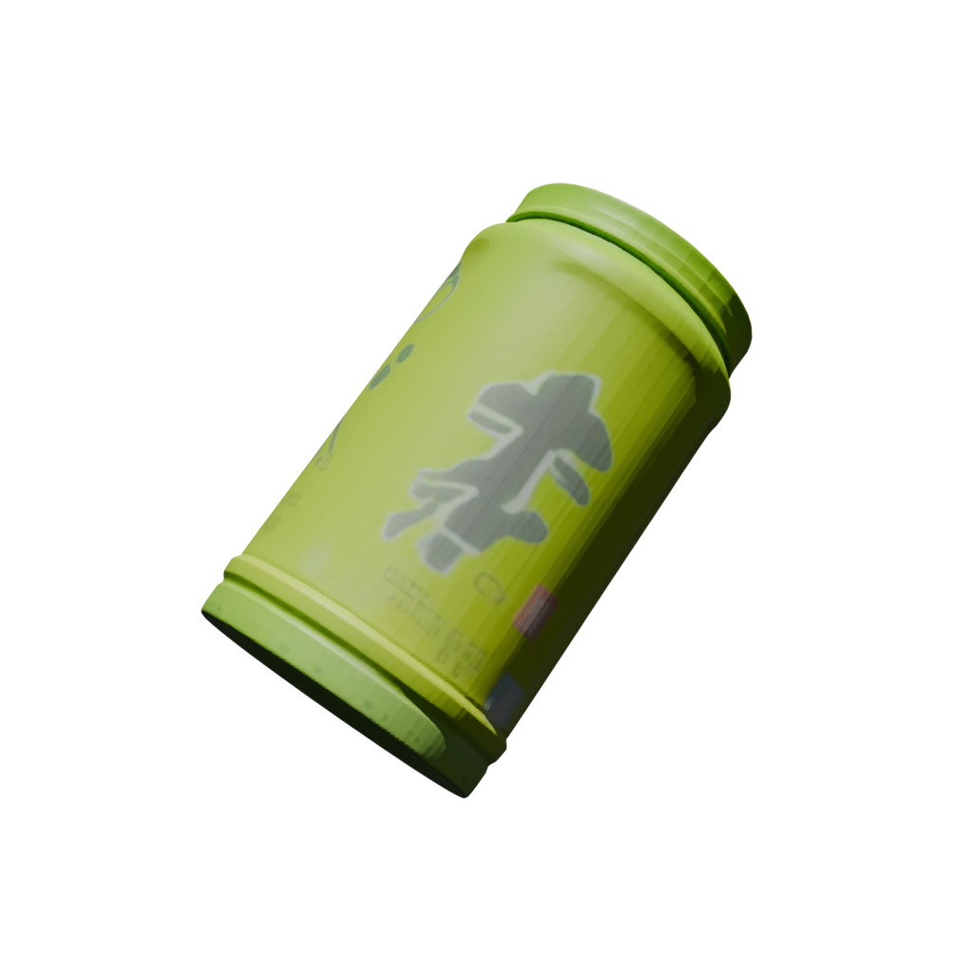
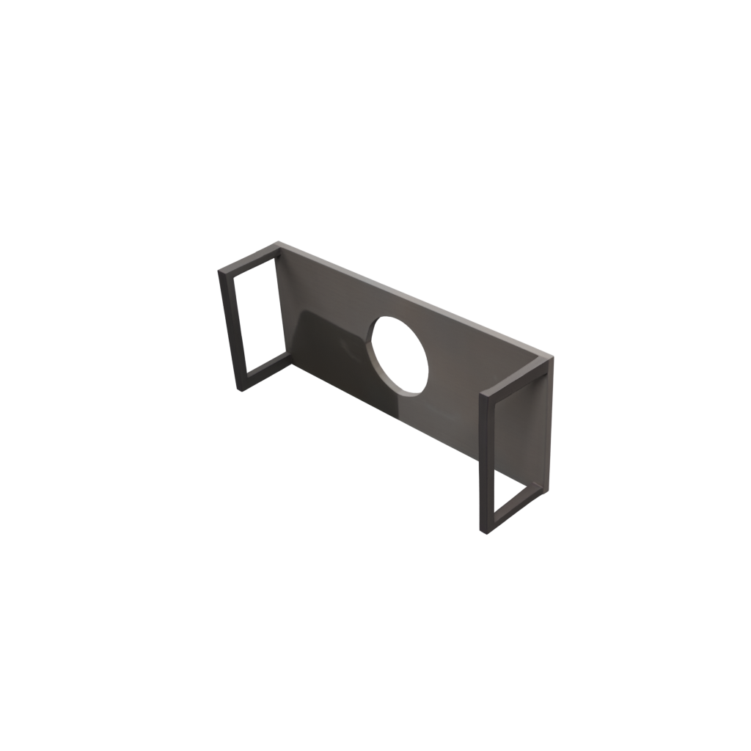
2026-02-03
VIGA Architecture & SAM3D Internals
Documented the full VIGA architecture hierarchy: VIGA -> SAM3D -> TRELLIS. Detailed SAM3D pipeline stages, tunable parameters, and VRAM optimization strategies. Created CLI tools reference for inference, visualization, and post-processing.
SAM3D Windows + Bottle Test
First successful SAM3D test on Windows native (not WSL). Green tea bottle reconstructed to 3D GLB. Debugged flat mesh issue — root cause was inverted mask input. Documented correct vs incorrect input images.
VIGA Workflow Documentation
Complete pipeline workflow documented: input processing, SAM segmentation, SAM3D reconstruction, Blender scene composition, and iterative refinement loop.

Slide 14
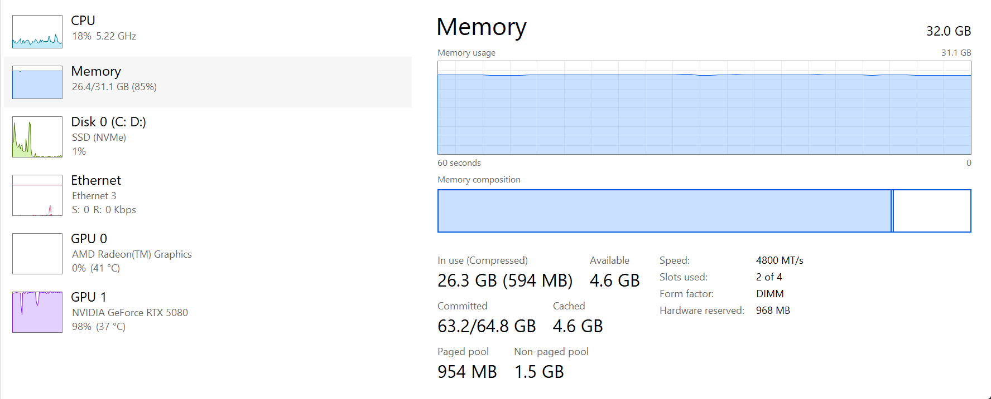
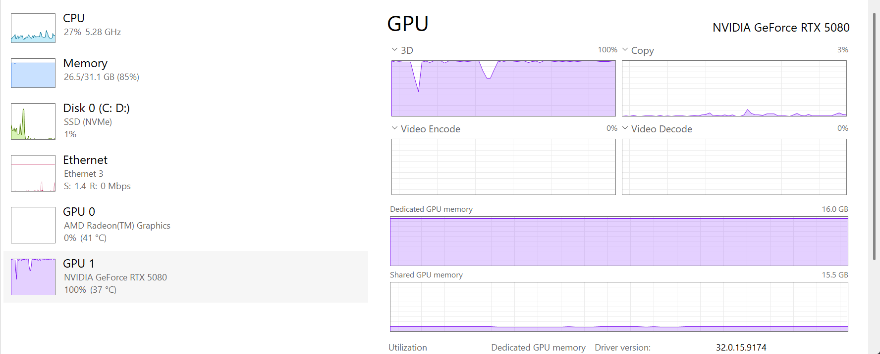
2026-02-01
SAM3D WSL Testing
SAM3D tested on WSL2 Ubuntu. Compared performance vs Windows — WSL showed ~30% faster inference and better VRAM efficiency. Documented OOM issues and memory optimization strategies.

Slide 15
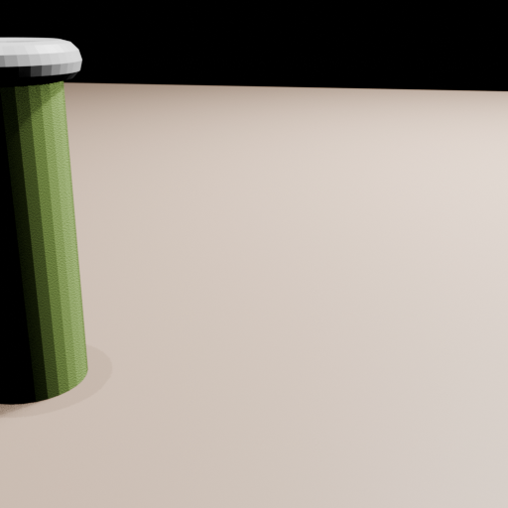
2026-01-30
VIGA Progress: Dynamic Scene Tests
Early dynamic scene pipeline testing with GPT-4o. Tested green tea bottle and artist (Cezanne) tasks. Established the dual-agent iterative workflow: Generator writes Blender code, Verifier evaluates renders.

Slide 16
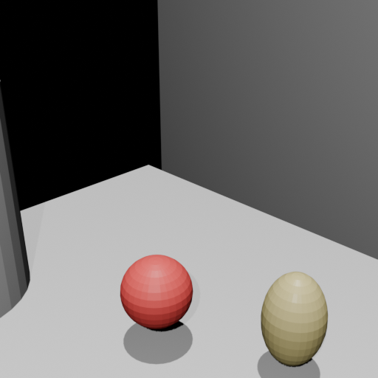
2026-01-29
VIGA Project Kickoff
Initial VIGA project setup and first test runs. Established the generate/render/verify loop. First successful end-to-end run: input photo -> VLM generates Blender Python -> rendered 3D scene. Documented pipeline modes: dynamic_scene, static_scene, BlenderGym, BlenderBench.

Slide 17
VIGA Project Summary
14 days | 31 docs | 5 pipeline modes | SAM3D + Meshy + Blender + GPT-5
Author: Yuna | February 2026

